Slide 1
Sea Safety and Coastal Pollution: Current Issues and Challenges
14th March, 2025
Byeon, Seongjoon (Ph.D., Newcon)

Slide 2
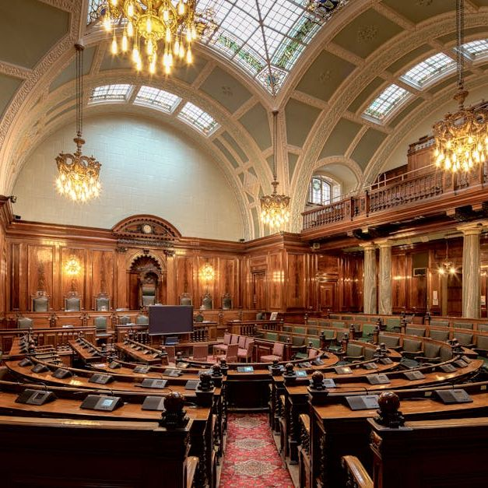
Committee Overview: Sea Safety and Coastal Pollution
Committee's Mission
The Sea Safety and Coastal Pollution Committee aims to mitigate maritime risks and combat coastal pollution through policy advocacy, technological advancements, and stakeholder collaboration.
Core Responsibilities
Our committee focuses on developing safety measures, enforcing environmental regulations, and fostering partnerships for cleaner oceans.
Relation to the YES Initiative
As part of the YES Initiative, we align with broader environmental goals to ensure sustainable maritime operations and pollution prevention.

Slide 3
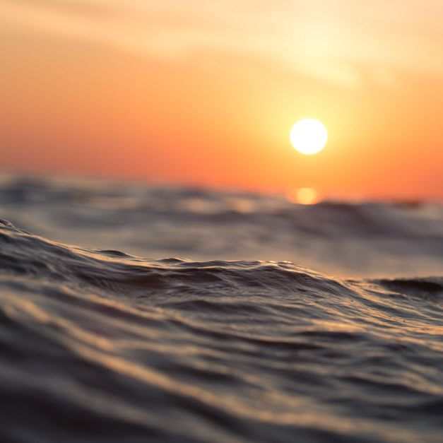
01
Impact on marine ecosystems and biodiversity.
02
Threats to human health and coastal communities.
Importance of Sea Safety and Coastal Pollution Prevention
03
Economic consequences for fisheries and tourism.
04
International regulations and environmental policies.
05
The role of the YES Initiative in addressing these issues.

Slide 4
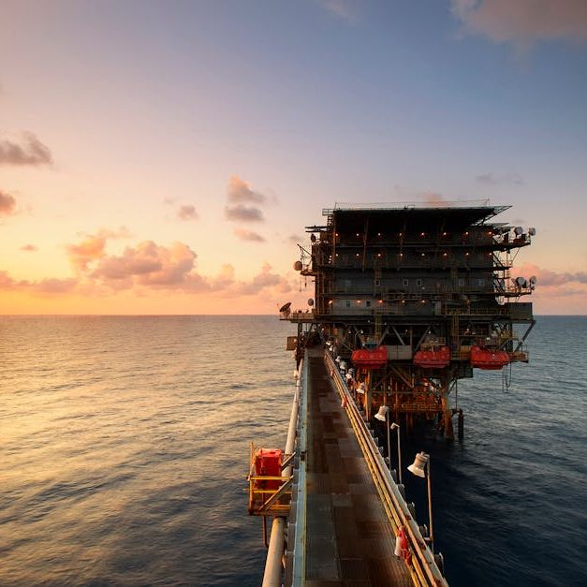
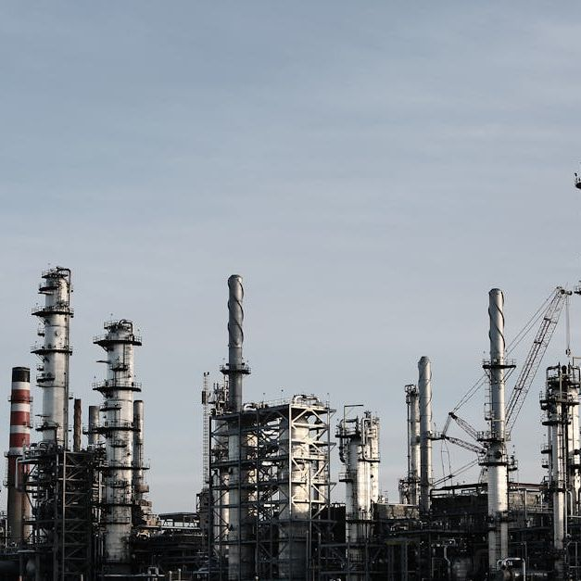
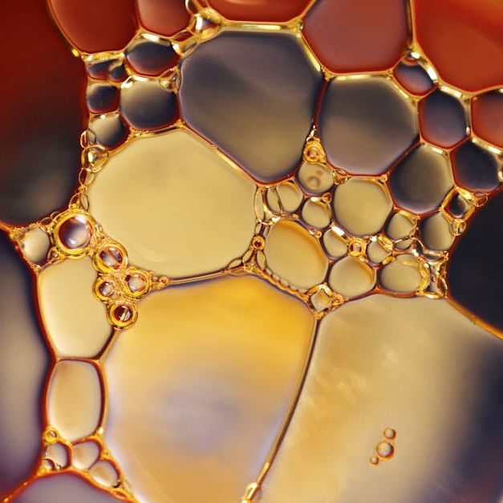
Key Issues in Sea Safety and Coastal Pollution
These are some of the most pressing challenges facing maritime safety and coastal environments today.

Slide 5
Key Issues in Sea Safety and Coastal Pollution
Oil Spills and Industrial Waste
Plastic and Chemical Pollution
Rising Maritime Accidents
Major oil spills have led to catastrophic environmental damage, endangering marine life and coastal economies.
Plastic waste, microplastics, and industrial chemicals continue to threaten water quality and biodiversity.
Increasing traffic and extreme weather conditions contribute to frequent maritime safety incidents.

Slide 6
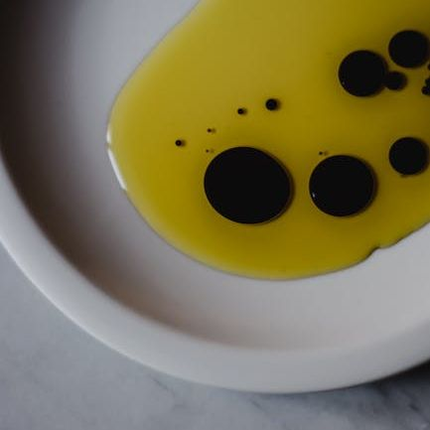
Case Studies of Major Incidents
Examining past incidents helps us understand the severity of coastal pollution and maritime safety failures.

Slide 7
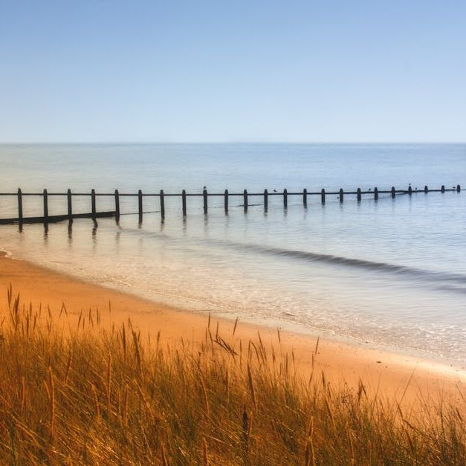
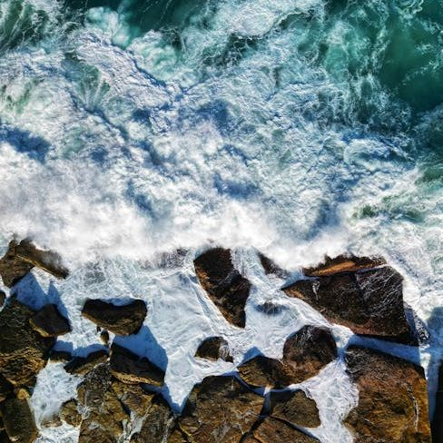
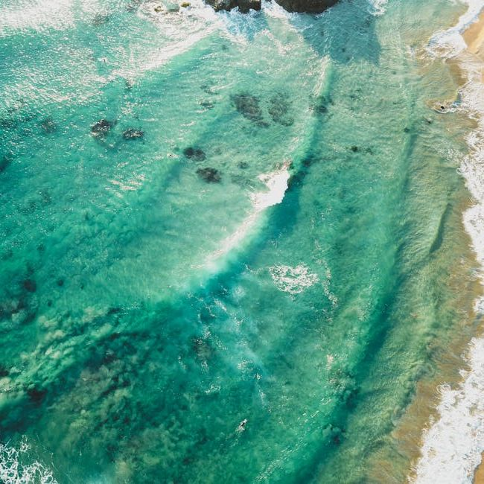
Solutions and Response Strategies
Innovative technologies and strong policies are key to addressing maritime safety and pollution challenges.

Slide 8
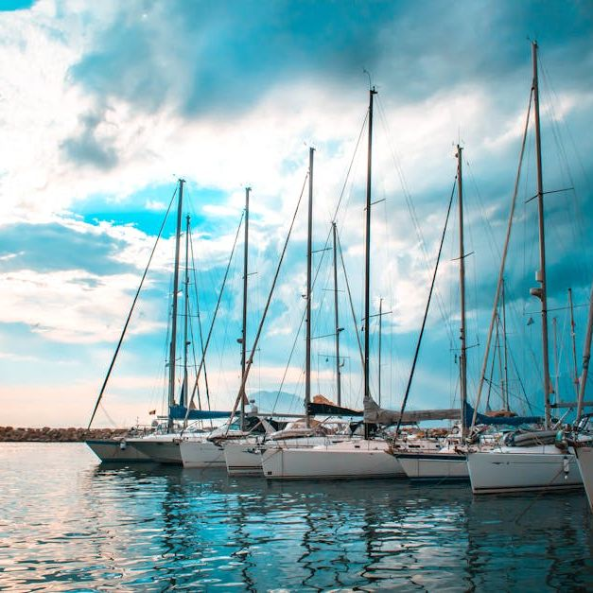
Challenges in Addressing These Issues
Lack of Strict Regulations
Despite international efforts, many regions lack stringent policies to prevent coastal pollution and enforce maritime safety.
Limited Technological Adoption
New monitoring and response technologies exist, but their implementation remains slow due to cost and regulatory hurdles.
Public Awareness and Engagement
Coastal communities and stakeholders often lack the necessary information and motivation to contribute to pollution prevention and safety measures.

Slide 9
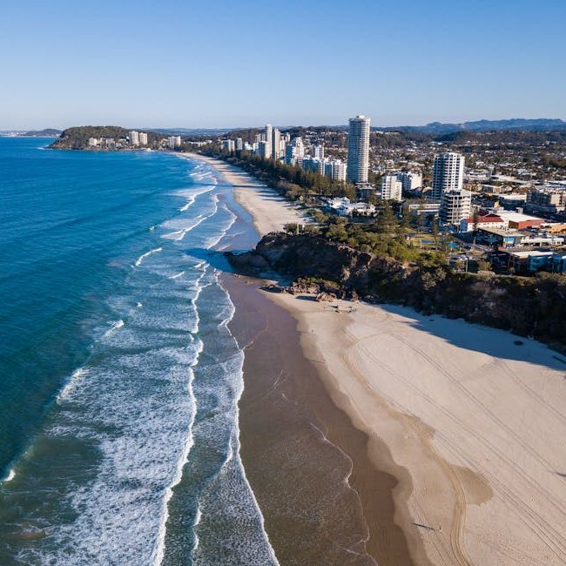
How can stricter policies improve coastal pollution control?
What role do new technologies play in maritime safety?
Stronger regulations can lead to more effective enforcement and compliance, reducing industrial waste and illegal dumping.
Innovations such as AI monitoring, satellite surveillance, and automated spill response systems enhance safety and pollution prevention.

Slide 10
Looking Forward
What are the main challenges we must overcome in the coming years?
Future Challenges and Strategic Goals
The Sea Safety and Coastal Pollution Committee must tackle growing industrial activities, climate-related threats, and the enforcement of international agreements. Strengthening collaboration, investing in new solutions, and engaging stakeholders will be key to making a lasting impact.

Slide 11
Final Thoughts
How can we collectively contribute to a safer and cleaner marine environment?
Conclusion and Call to Action
By embracing innovative solutions, enforcing regulations, and fostering international cooperation, we can protect our oceans for future generations. Our committee plays a pivotal role in shaping these initiatives—let’s take action together!

Slide 12
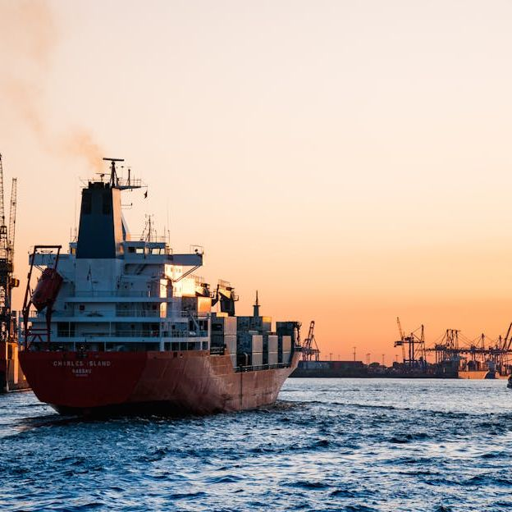
Current Issues and Trends in Sea Safety and Coastal Pollution
Increasing Coastal Pollution
Coastal pollution has been rising due to plastic waste, oil spills, and untreated industrial discharge, affecting marine life and ecosystems.
Maritime Safety Challenges
Rising maritime accidents, climate change effects, and outdated safety protocols pose significant threats to sea safety.
Regulatory Changes and Technology
International organizations are strengthening regulations while AI and drone technologies are being adopted to enhance monitoring and enforcement.

Slide 13
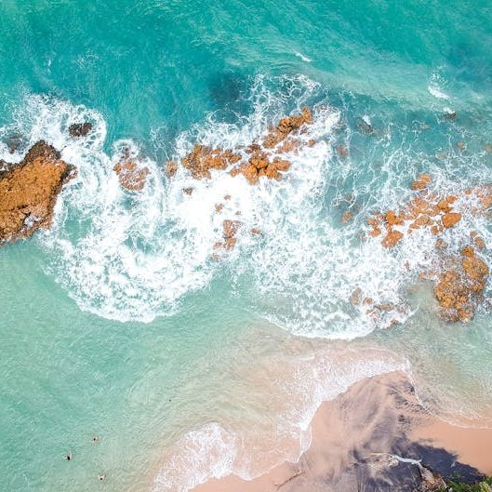
Solutions and Response Strategies
Strengthening Pollution Prevention Policies
Governments and organizations must enforce stricter regulations on industrial waste, oil spills, and plastic pollution.
Enhancing Maritime Safety Measures
Advanced tracking systems, emergency response improvements, and crew training are essential for reducing accidents.
Community Engagement and International Cooperation
Collaborative efforts between nations, NGOs, and local communities are crucial for effective solutions.

Slide 14
Collaborative Solutions
How can we contribute to improving sea safety and reducing coastal pollution?
Future Directions and Our Role
Our committee plays a crucial role in addressing these challenges by fostering policy development, technological advancements, and stakeholder cooperation. By working together, we can ensure a safer and cleaner marine environment for future generations.

Slide 15
Discussions

